Slide 1
Content table
EDA (Slide2 to 6)
Use of Market Basket Analysis (Association Rules) -->Write Something about the association rules and its relevance in this case -->Add KNIME workflow Image or Python package used -->Write about threshold values of Support and Confidence (SLIDE 7 TO 10 )
Associations Identified --> Put the associations in a tabular manner --> Explain about support, confidence, & lift values that are calculated (Slide 11 to 14)
Suggestion of Possible Combos with Lucrative Offers --> Write recommendations --> Make discount offers or combos (or buy two get one free) based on the associations and your experience. (Slide 15 to 17)

Slide 2
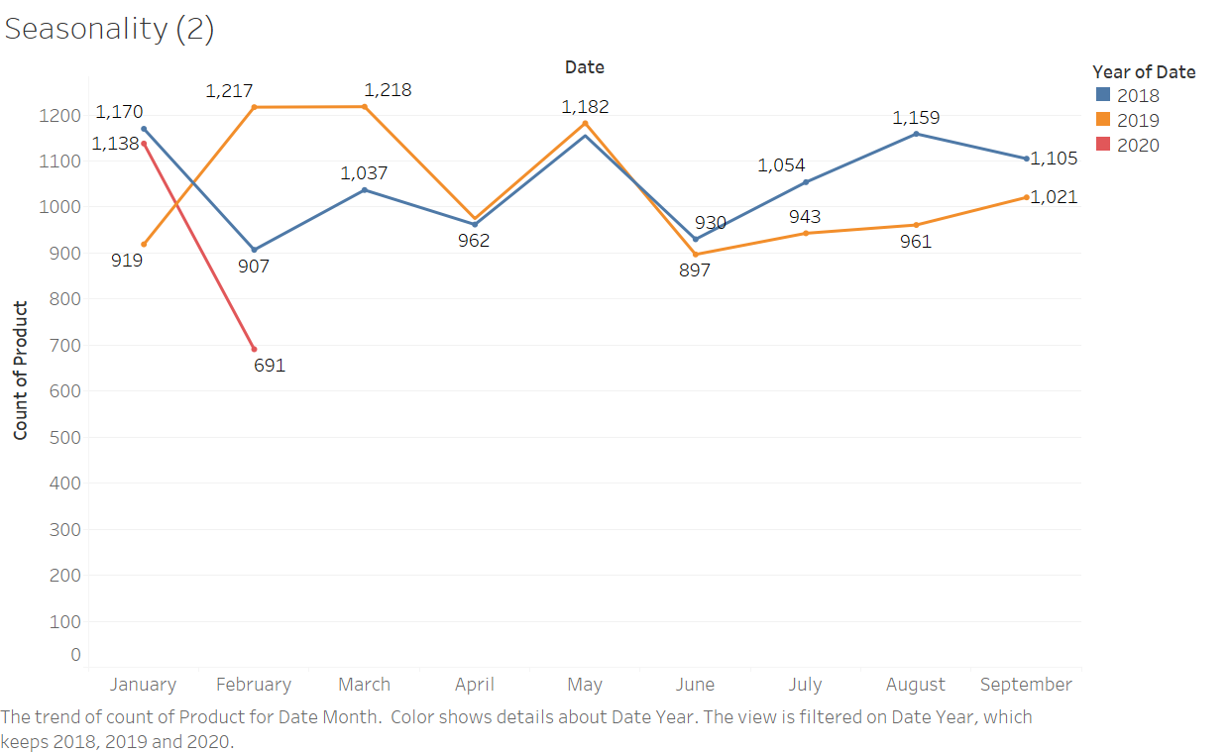

Slide 3
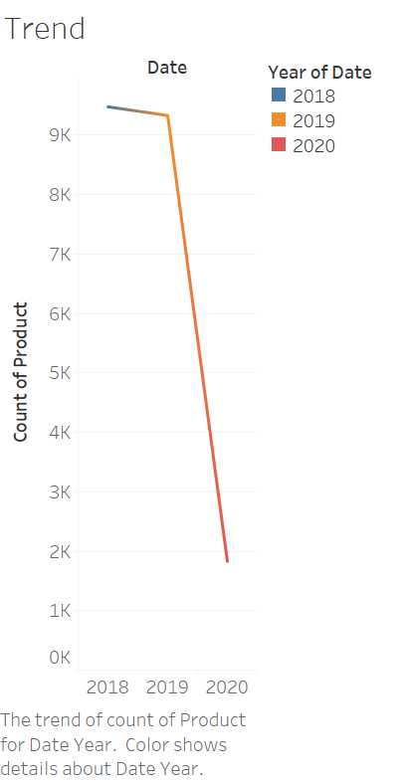

Slide 4
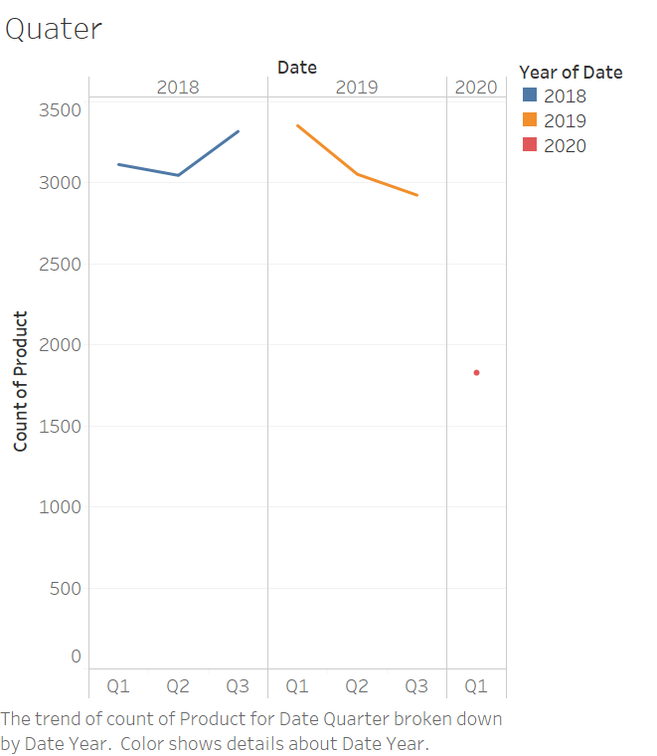

Slide 5
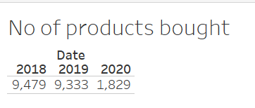

Slide 6
Exploratory Analysis --> Exploratory Analysis of data & an executive summary (in PPT) of your top findings, supported by graphs. --> Are there trends across months/years/quarters/days etc. that you are able to notice?
From the plot we can clearly see that there is no proper evidence for seasonality in the data. Only similarity between the 2018 and 2019 is that in the month of May in both the years the sales is increased. There is no clear trend also in the data. However, the sales has decreased in 2019 compared to 2018 and since there is no full data for 2020 we cannot say much. Image 1
It is also noticed that there is not full data present for 2020. We have the data only till February. For the year 2018 and 2019 the data we have is from January to September. (Image 1)
Number of products bought in 2018 is 9479 and in 2019 it has dropped to 9333. There is not a much of a difference here. This can be seen in the year chart. (Image 2)
From the quarterly chart we can see that during 2018 after a dip in Q2 in Q3 the no of products sold we higher. However, in 2019 the no.of products purchased have been dropping. For 2020 there is data only till February, so the quarter data is not available.
The no.of. Purchase in 2020 is much lesser in the month of February when compared to 2018 and 2019. in 2018 the purchases stood at 907 units of products and in 2019 it was 1217 units. in 2020 it is only 691 units.
In the original data the data was split into various rows for same order id. We have to groupby order id so that it is made into one record.

Slide 7
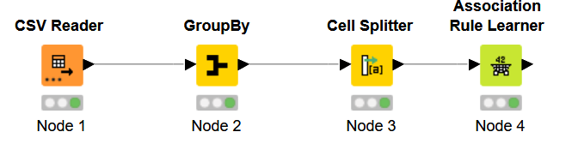
Use of Market Basket Analysis (Association Rules) -->Write Something about the association rules and its relevance in this case -->Add KNIME workflow Image or Python package used -->Write about threshold values of Support and Confidence

Slide 8
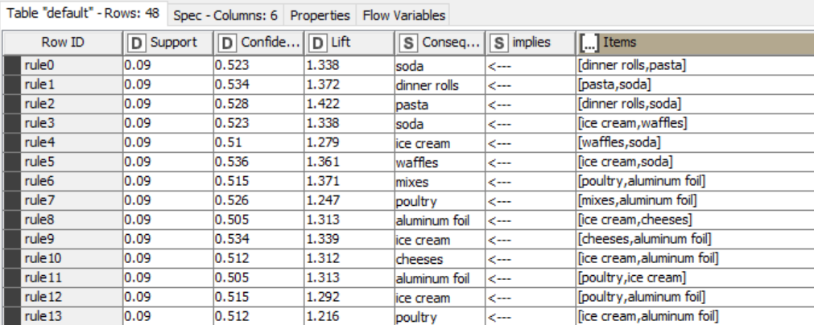
Use of Market Basket Analysis (Association Rules) -->Write Something about the association rules and its relevance in this case -->Add KNIME workflow Image or Python package used -->Write about threshold values of Support and Confidence

Slide 9
Use of Market Basket Analysis (Association Rules) -->Write Something about the association rules and its relevance in this case -->Add KNIME workflow Image or Python package used -->Write about threshold values of Support and Confidence
Association Rule relevance: Association rule is important for market basket analysis because in this node only we decided what percentage of customers basket do we need to analyze.
Before the data is passed to association rule, we must make the product column into sets as association rule needs sets. Before the data is passed to the association rule, we have an option to remove records that have same product mentioned again. The duplicate products in same orders can be avoided but selecting the cell splitter and when we make the product column as set the duplicates are removed.
The order id was not grouped by in the data we have used the groupby node to make the order id into one record and then all the products in the order will be in one row.
In the association node we must enter the minimum support and the confidence level. Minimum support is used to find out what percentage of our customers basket should contain the commonly bough products. If we say the support to be at 0.50 then the association rule will show commonly bought products that are there in 50% of our customer baskets.
Association rule maps what all products are frequently bought by earlier customers and if a new customer buys a similar combo and misses one product that was frequently bought by other customer, that product can be suggested.
In the image we can see that customer who bough dinner roll and pasta have bough soda frequently. So, when a new customer buys only dinner roll and pasta we can suggest the customer if he need to add soda to his basket.
contd

Slide 10
The threshold I have used for this data set is support of 0.09 so almost 10% of the customers basket will have the given combo of products. The confidence is set at 0.5. when we increase the support level the number of records will be less as we need higher percentage of customers to have products that are bought in similar combo or pattern.
In the association rule another important is part is the lift value. Higher the lift value the better. If there are two products In the basket and there are two combination of suggestions then, we can check which combination has the higher lift value and based on the value we suggest the highest value combination first.
The consequent column show what product can be suggested to the customer if there are two products in his cart. E.g.: in our association rule output we can see dinner roll and pasta in the customer basket then we can suggest the customer to buy soda because previous customers who bought dinner roll and pasta have bought soda.

Slide 11

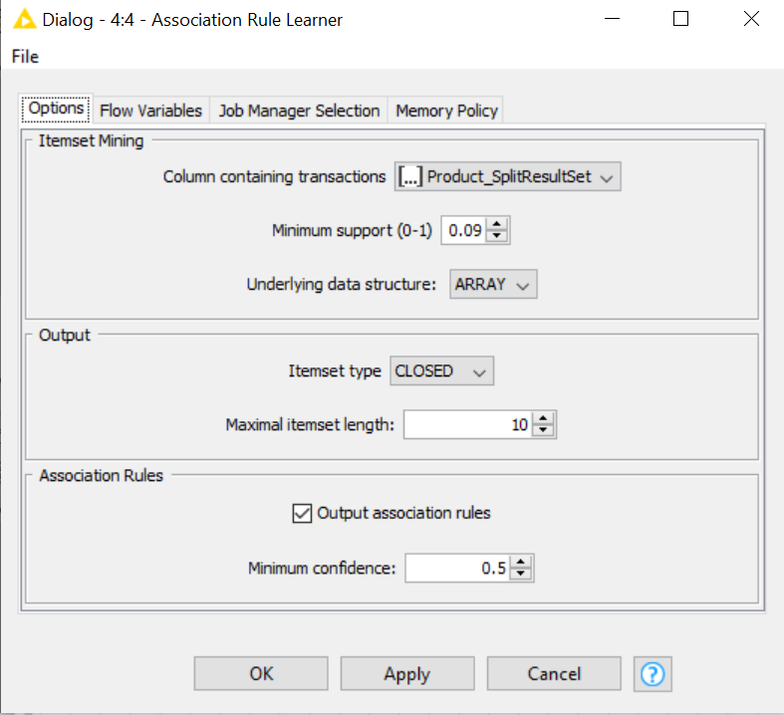
Associations Identified --> Put the associations in a tabular manner --> Explain about support, confidence, & lift values that are calculated

Slide 12
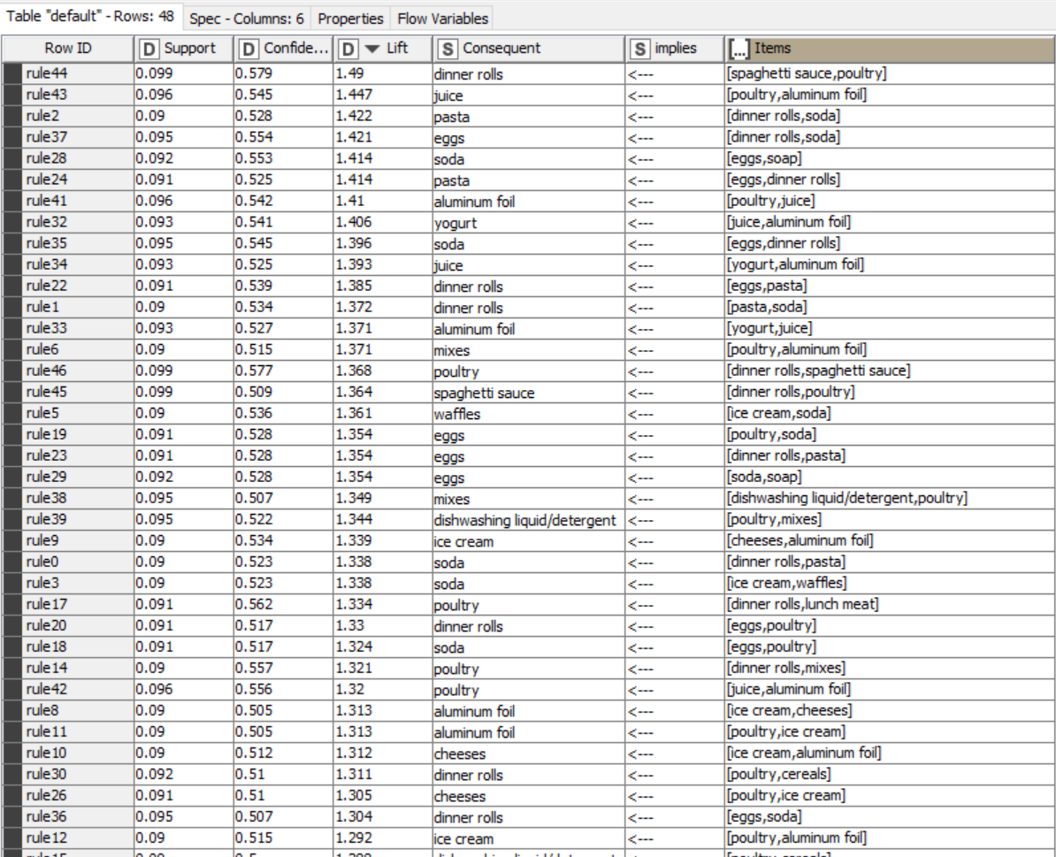

Slide 13
Slide 10 and 11 are the images of the association rule configuration and the output of association rule.
Support: This is used to find what percentage of customers will be having the similar purchased products in their basket. I have kept the support at 0.09 9%. This means that 9% of the customer basket will have those products in their basket. So, in support we check the percentage of customer basket that contain certain products. Higher the support better because we have more customers to see their shopping habits. Support is represented by a formula freq(x,y)/n. e.g.: if there is a set of products such as bread,butter,jam being bought frequently then that is divided by the number of total customers. If total customers are 100. The bread, butter, jam combo has been bought by 10 customers then the support will be 10/100=0.1.
Confidence: This measures percentage of time product X is purchased given y is already there in the basket. The confidence of product X being in basket being y already there. Higher the confidence level the lesser will be the list of products. For this data I kept chosen a confidence of 0.5. when the confidence is increased there are not records that are displayed.
Lift value: The higher the lift value better the combination of products. Lift value is calculated by number of times products appear together. Eg if bread and butter are appearing together, and it is found to appear the most then the lift value for this combo will be higher than the rest.

Slide 14
In slide 11 we can see the output of the association rule. According to the support and confidence level that is set we have around 48 records.
Among the 48-records spaghetti sauce and poultry are mostly purchased together. And another product customer can be suggested when they buy this combo is dinner rolls. When customers purchase spaghetti sauce and poultry, they buy dinner rolls also. Our first record shows that. The lift value for this combo is 1.49. The product with least life is when customers purchase only dinner roll then poultry is suggested. The support and confidence is also the lowest for this combo.

Slide 15
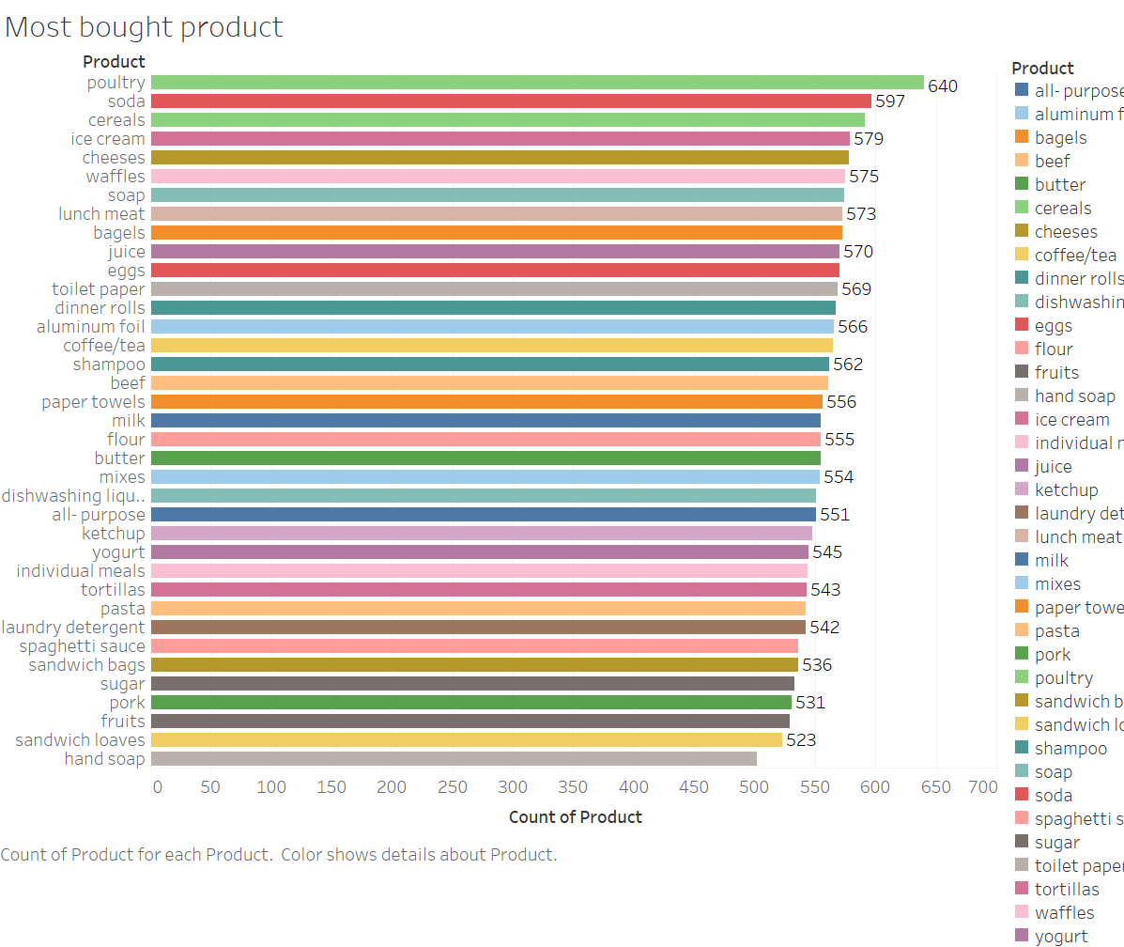
Suggestion of Possible Combos with Lucrative Offers --> Write recommendations --> Make discount offers or combos (or buy two get one free) based on the associations and your experience

Slide 16
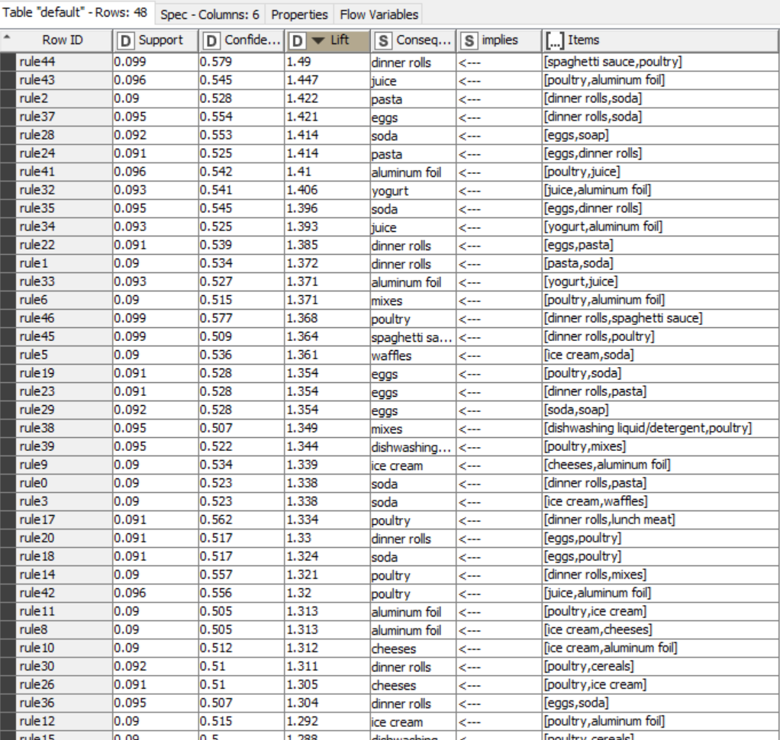

Slide 17
Suggestion of Possible Combos with Lucrative Offers --> Write recommendations – -> Make discount offers or combos (or buy two get one free) based on the associations and your experience
The most purchased product is poultry. Poultry has been bought 640 times.
One discount offer we can make is people who are buying more than one poultry can buy a dinner rolls at 20% off. In this offer since people are already buying poultry can opt for a dinner roll at a cheaper price. Since these both are bought by customer, we can make the customer purchase more so that our sales increases.
Another popular combo is dinner roll, egg, and soda. We can offer free soda for people buying more than 30 egg and 2 dinner roll together. Since already people are buying these three combination, we can push for more sale of dinner roll and egg and give one soda free.
Yogurt are bought very less, and the shelf life of yogurt is less. We can bundle and offer yogurts to people who are buying eggs and dinner roll and promotion customers to have yogurt as a healthy meal. We can make a protein rich package but bundling egg, poultry and yogurt along with it. This way the sales of yogurt will also increase.
Since poultry don’t have good shelf life the near to expiry poultry products can be offered a discount when two or more are bought.

Slide 18
Tableau Workings
https://public.tableau.com/views/Project2marketing/Trend?:language=en&:display_count=y&publish=yes&:origin=viz_share_link

